Slide 1
Developing a Staff Leadership Academy
Dana Yarbrough dvyarbrough@vcu.edu

Slide 2
do we mean by leadership?
is leadership development important for people with IDD and family members on staff?
do we do it?

Slide 3
Notes:
Before I begin – let me clarify who I am talking about participating in the leadership academy I developed at our UCEDD. For the past two years, the work has primarily been focused on 25 staff who work under the Center for Family Involvement. Formed in 20015, the CFI currently has $1.2 million in funding from 6 federal and state agencies to provide emotional, informational and systems navigational support to children and young people with IDD and their families. There are 24 staff – two are people with disabilities and the rest are family members (mostly parents). Three years ago – I was the only person directing, managing, leading and supervising the CFI. It was a hollow structure and bad business to not have others involved in these roles – if I left. I was saying this to upper management, but it didn’t seem to get through. That’s when I decided to invest in my own leadership development to ensure I was a more effective communicator.

Slide 4
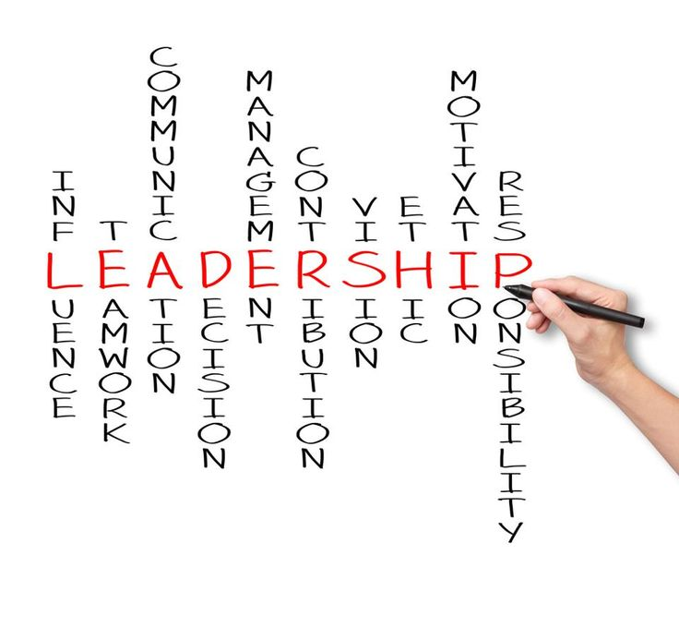
How I Approached Leadership Development in my Personal Life…
Notes:
Read books
Was selected for the AMCHP family leader lap
Read more books
Was selected for the Georgetown cultural competency leadership cohort in 2017
Read even more book
Utilize a confidant and also a mentor
Still reading books

Slide 5
do we mean by leadership?

Slide 6
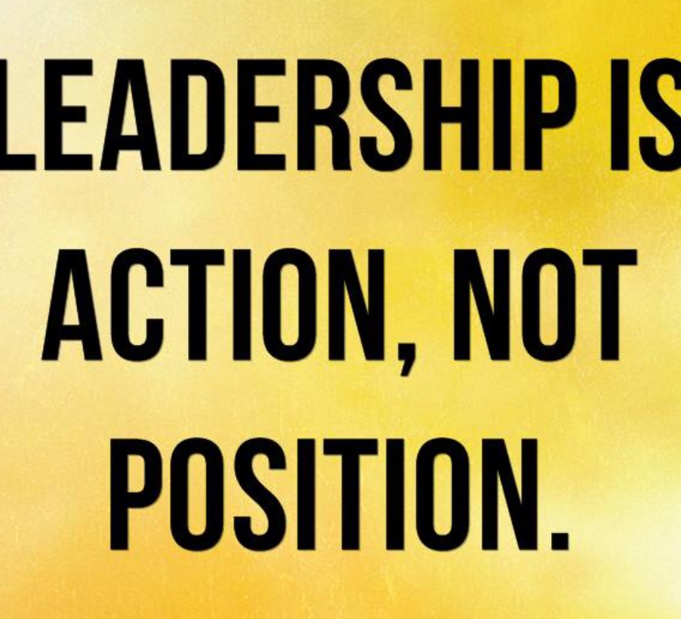
…it is a set of behaviors that inspires and motivates those around you to act
Notes:
Leadership is about relationships. Leaders bring people together, mobilize resources, ask and reflect. Someone once told me that you don’t have to like the people you work with…you have to love them. I’ll be honest – I didn’t love all the people I hired and supervised. I knew that I needed to get to know them in a different way so I could love them.
Genetic – born with leadership attributes (assumed leadership)
Learned – study, practice leadership so you can be an effective leader
Heroic – choragus acts
Top Only – role at top of organization
Social Script – you’ll be asked when it is the right time to be a leader and you’ll be grateful
Position – leadership is assumed because of your role
Calling – moves you to lead

Slide 7
Leadership
Management

Slide 8
Leadership vs Management: Is there a difference?
Management = the PRESENT
keep things stable, make decisions according to a plan, maintain status quo
Leadership = the FUTURE
create discomfort, action happens because of a vision

Slide 9
is leadership development important for people with IDD and family members on staff?

Slide 10
Why Building Leadership Behavior is Important
It shows you value them, respect their potential, and think they would be good leaders, which can help them believe in their own possibilities
It models the kind of inclusive leadership that good leaders practice.
It’s a mark of respect and fairness to include potential leaders in decisions that have a bearing on their work and perhaps on their lives.
Notes:
Many of the people with disabilities and family members working at the PPD do not have any education beyond a high school diploma or GED. Our office, particularly the Center for Family Involvement, housed in an academic setting, creates a barrier for their promotion if they do not have a college degree.
Commitment (to organization, to our vision, our purpose)
Perseverance (
Motivation (to achieve their personal best)
Communication (active listening skill building)
http://ctb.ku.edu/en/table-of-contents/leadership/leadership-ideas/plan-for-building-leadership/main
Perhaps the most powerful lessons leaders learn come from watching the behavior and actions of leaders they respect. If you want someone to learn a leadership skill, you should be practicing that skill yourself and be making sure that other leaders in your organization or initiative do so as well.
Third, the people you’re training may have a better grasp on what they need than you do. If they’re included in planning their training, it’s more likely that the training will be appropriate.

Slide 11
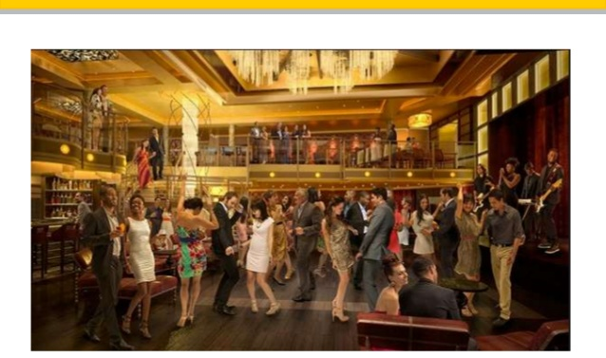
Moving Between the Balcony and the Dance Floor
Notes:
The academy – I am going to share tools in a minute - was designed to get staff at both the balcony and the dance floor level. What do I mean by that? My job as the CFI director, the CFI principal investigator, and the Partnership’s Assistant Director is to constantly move between the balcony and the dance floor. That means I have to stay on the balcony, at a birds eye view, watching that all the dancers are moving to the right music..are doing the same dance. And, there are times I am on the dance floor twerking alongside you planning a ParentCamp, running a meeting, etc. I want all of them to do the same – how do they take a break from the dance floor and get up on the balcony to watch the dancers (maybe that is our family navigators, maybe that is our event participants)

Slide 12
Its About Being Brave and Having Difficult Conversations
Create a culture of safe climates for conversations
B – boundaries
R – reliability
A – accountability
V – vault
I – integrity
N – non-judgmental
G - generosity
Stepping into the VOID
Source: Brene Brown
Notes:
When we face contentious issues When two worthwhile principles come into conflict with one another. When there are feelings about rights. Its scary and intimidating to open yourself. Sometimes, avoiding conversations arises from our own fears of being vulnerable.
Defense mechanisms can impede conversations.
Remember – disagreements and debate are different than criticism. Questions are seen as antagonism rather than being valued as learning. People will silence themselves or agree to disagree without fully exploring the actual nature of the disagreement for the sake of preserving a relationship. When we avoid conversations and never fully learn how the other person feels about the issues, we can make assumptions that deepen the misunderstanding and generate resentment

Slide 13
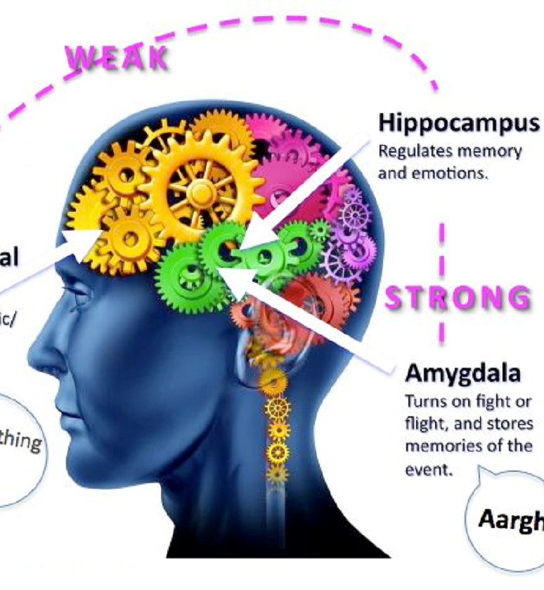
Notes:
At a more finite level, it is important to build leadership behaviors in staff who are at the front line – supporting people with IDD and families calling for help who are often in crisis or overwhelmed with what to do and where to go. How do I ensure they are not burnt out or are in flight or flight mode.

Slide 14
do we do it?

Slide 15
How I Approached Leadership Development Where I Work…

Slide 16
CFI Staff Leadership Academy Activities
Self-Assessment Exercises
Innovation Styles
Strength Finders 2.0
Supercapes/Cloaks of Humility
Systems Mapping
Language of Appreciation
Emotional Intelligence
Notes:
Later we will assess our CFI/F2F organizational culture as we continue to set a vision for the future of the CFI, set high performance expectations for each one of us, and build caring for our fellow workers. Innovation styles tell us how a person will make the best contribution to innovation – generating ideas? Linking ideas together? Turning ideas into practical solutions? Or implementing solutions? From the Motivating by Appreciation Inventory by Gary Chapman and Paul White, a person identifies their individual preferred language of appreciation (words, physical touch, acts of service, quality time, tokens) which when provided to them by others, cements job satisfaction and trust.

Slide 17
CFI Staff Leadership Academy Activities
Learning Opportunities
Neuroleadership and brain science (what's going on with the brain when we make decisions, collaborate, regulate emotions, and facilitate change; the biology of moving change forward - what drives behavior and motivation).
Mindfulness (cultivating and strengthening our mind's capacity - mind's propensity to narrow the focus when under stress; negative effects of information overload)
Energy management (strategies to re-energize body, mind, spirt and emotions)
Generational communication (being emotionally intelligent requires awareness of your audience – who you are speaking to as a group and individually)
Notes:
Later we will assess our CFI/F2F organizational culture as we continue to set a vision for the future of the CFI, set high performance expectations for each one of us, and build caring for our fellow workers. Tom Rath’s Strength Finder 2.0 exercise identifies a person’s top talents and how they interact with that person’s skills, knowledge, and experience. Most people have dominant, natural talents and strong elements of personality – the person then adds skills, knowledge and strengths to the mix as they mature and have different experiences – but it is important to note that the person’s core talents are less likely to change regardless of their role on a team or project.
Innovation styles tell us how a person will make the best contribution to innovation – generating ideas? Linking ideas together? Turning ideas into practical solutions? Or implementing solutions? Peter Merrill’s Community of Innovation tool helps a person identify their most valuable contribution to the team: Creators find the opportunity and open it up (researchers); Connectors nurture the seed of the idea (strategic planners); Developers make the idea work (engineers); Doers get the job finished (project managers). From the Motivating by Appreciation Inventory by Gary Chapman and Paul White, a person identifies their individual preferred language of appreciation (words, physical touch, acts of service, quality time, tokens) which when provided to them by others, cements job satisfaction and trust.

Slide 18
CFI Staff Leadership Academy Activities
Reflection
Journal or blog about your experience/thoughts during this process -what are you feeling? What are your AHA! moments? Do you see the CFI team differently or your role on the team differently? Do you have ideas for change? How would you use what you learn with the volunteer Family Navigators you're matching with families and/or with the families you are supporting?
Evaluation
At the end, the CFI/F2F evaluator will conduct a survey on your experience (what worked well, didn’t work well; what did you learn; what should we do differently)

Slide 20
Creating a Community of Innovation
Going row by row, of the 4 statements, put a 1 next to the statement that is least like you, a 4 next the statement that is most like you, and a 2 and 3 next to the others, depending on how most/least like you they are. Then, total each column
1 | I “connect the dots” |  | I get things done |  | I like possibilities |  | I bring things “down to earth”
2 | I need to understand |  | I make things work |  | Everything has a good and bad side |  | There has to be a right answer
3 | Don’t tell me what to do |  | Give me the facts not theory |  | I create choices |  | I like to analyze data
4 | A concept must be sound |  | I like “energy” |  | Don’t fuss with details |  | I like precision
5 | I think things through |  | I take risks |  | I like to hear about problems |  | I focus
6 | I like the big picture |  | I find a way that works |  | I want to own the problem |  | I am thorough
7 | I like to define the problem |  | I push for acceptance |  | I find out the facts |  | I plan
 | Total |  | Total |  | Total |  | Total
Source: Peter Merrill
Notes:
Peter Merrill’s Community of Innovation tool helps a person identify their most valuable contribution to the team: Creators find the opportunity and open it up (researchers); Connectors nurture the seed of the idea (strategic planners); Developers make the idea work (engineers); Doers get the job finished (project managers).

Slide 21
Creating a Community of Innovation
CONNECTORS | DOERS | CREATORS | DEVELOPERS
Find solutions | Get the solution “out there” and being used | Find the opportunity (see the need/problem) | Make the solution work (user friendly)
How will you make the best contribution to innovation?
Generating ideas
Linking those ideas together
Turning ideas into practical solution or
Implementing solutions + getting things done?

Slide 22
Leading with Strengths
Achiever | Empathy | Responsibility
Activator | Ideation | Woo (winning over others)
Adaptability | Deliberative | Positivity
Analytical | Maximizer | Strategic
Arranger | Harmony | Restorative
Command | Input | Relator
Developer | Discipline | Belief
Context | Self-Assurance | Includer
Communication | Intellect | Futuristic
Connectedness | Focus | Significance
Consistency | Individualization | Learner
Competition
Source: Tom Rath
Notes:
Tom Rath’s Strength Finder 2.0 exercise identifies a person’s top talents and how they interact with that person’s skills, knowledge, and experience. Most people have dominant, natural talents and strong elements of personality – the person then adds skills, knowledge and strengths to the mix as they mature and have different experiences – but it is important to note that the person’s core talents are less likely to change regardless of their role on a team or project.

Slide 23
Leading with Strengths
Executing | Influencing | Relationship Building | Strategic Thinking
Achiever, Arranger, Belief, Consistency, Deliberative, Discipline, Focus, Responsibility, Restorative | Activator, Command, Communication, Competition, Maximizer, Self-Assurance, Significance, woo | Adaptability, Developer, Connectedness, Empathy, Harmony, Includer, Individualization, Positivity, Relator | Analytical Context, Futuristic, Ideation, Input, Intellection, Learner, Strategic
Notes:
So why was learning about innovation styles and strengths important? Have you ever sat in staff meetings, in meetings to plan a conference, to develop a new training, etc.? If you are a creator, a strategic thinker, you are operating at 30,000 feet. You can dream about – see the future of whatever is being discussed. If you are the developer or influencer, you are trying to make more sense of the big picture – to bring it down to something that looks achievable…not so pie in the sky. If you are the relationship builder or connector, you are already thinking about how the discussion, the topic, the idea, relates to something we have already done or that XYZ company has something similar. If you are the doer, the executor, you are frustrated with all the big ideas and all the wasted discussion. You just want your list of things to do and to start doing them.
Learning more about the styles of your staff and of your co-workers provides the opportunity to bring the right people to the table at the right time. Lets get creative, out of the box about something. Then meet with the developers and connectors to fine tune the idea. Finally, give the doers their action steps.

Slide 24
Languages of Appreciation
The single highest driver of engagement is whether or not a person feels their co-workers and supervisors are genuinely interested in their wellbeing.
A person identifies their individual preferred language of appreciation
 words  physical touch  acts of service
 quality time  tokens
Source: Gary Chapman & Paul White
Notes:
From the Motivating by Appreciation Inventory by Gary Chapman and Paul White,
There are financial, relational, and practical benefits of acknowledging the contributions of employees in ways that are meaningful to the recipient.

Slide 25
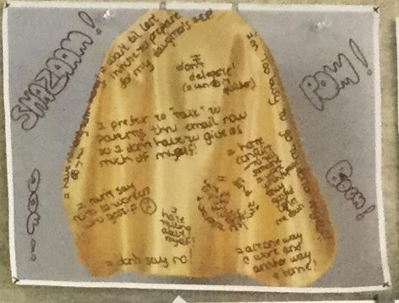
Wearing Supercapes
and Cloaks of Humility
Notes:
A phenomenan with many parent advocates and those leading in communities is one of wearing a supercape. That somehow, being the parent of a child with a disability required super powers to know SSI, Medicaid and Special Education laws frontwards and backwards…to be a teacher, lawyer, therapist, nurse, and case manager in addition to being a mom or dad.

Slide 26
Cape Activity

Slide 27
System Map
ROLE
RESPONSIBILITIES
NEED
RESOURCES
WISHES
Source: MCH Workforce Development Center
Notes:
http://people.renci.org/~stevec/ssm
List your role in the CFI
What are the main responsibilities of your role (interested to see if people in the same job listed the same responsibilities)
What do you need to do your role/complete your responsibilities
What resources do you have/can you tap into
Is there anything you wish you had or wish would happen that is outside of your needs and resources

Slide 28
Notes:
I think this activity is helpful in understanding how people view their role (how they operationalize their job description). How resourceful are they – do they problem solve.

Slide 29
Emotional Intelligence
Notes:
From research, a list was developed of the top ingredients of highly effective leadership behavior. Emotional intelligence proved to be more important than IQ and more important than technical skills like planning. It doesn’t mean those skills aren’t important, and we are doing a lot of that work this weekend, but Emotional Intelligence is critical for high performance. From that research came 5 skills that are exhibited by emotionally intelligent people
Self-Awareness (known your own strength’s, values, drives, weaknesses, and impact on others)
Self-Regulation (controlling your moods and impulses)
Motivation (being driven to achieve)
Empathy (understanding other people’s emotional makeup and considering their feelings when making decisions)
Social Skills (building rapport with others to move them in desired directions)
All of us are born with some level of each skill and increases with age (Yay me – an old wean bag). We can also increase them through training, practice and mentoring by others.
People who are self aware can realistically assess themselves. They are candid about their strengths and areas for improvement. They are self-confident. They know when to ask for help. They want constructive criticism.
People with good self-regulation are in control of their feelings and impulses. They create environments of trust and fairness. They roll with the changes. They suspend judgement, seek out info and listen to others when something new is discussed.
People motivated to achieve are passionate for the work itself. They seek out creative challenges, love to learn, take great pride in a job well done. They have unflagging energy to do things better. They are persistent question askers and eager to explore new things and approaches.
People with high empathy aren’t trying to please everyone or take on other’s emotions as their own. Instead they thoughtfully consider others feelings along with other factors in the process of making an intelligent decision. They understand the viewpoints of everyone around the table.
Socially skilled people have wide circles of acquaintances and a knack for finding common ground with people of all kinds – they build rapport. They work with the assumption that nothing important gets done alone. They are adept at managing teams. They are expert persuaders.

Slide 30
Emotional Intelligence Activity
0 = Never 1 = Almost Never 2 = Rarely 3 = Sometimes 4 = Often 5 = Always
1. |  | I am usually awareness of my feelings and why I feel that way
2. |  | I am aware of my strengths and weaknesses
3. |  | I recognize how my feelings affect my performance
4. |  | I manage my negative emotions well (I recover quickly when upset/stressed)
5. |  | I can keep my focus on goals and know the steps it takes to get there
6. |  | I welcome candid and constructive feedback
7. |  | I can usually sense the feelings of people I interact with
8. |  | I use empathy to understand what others are saying and how they are saying it
9. |  | I pay attention to what others are saying and how they are saying it
10. |  | I can persuade people easily (use my influence effectively)
11. |  | I can guide a negotiation to a satisfactory agreement
12. |  | I can effectively foster teamwork and help settle conflicts
Notes:
Every workplace is comprised of people with different strengths, personalities and emotions, which can greatly affect the way they work. It is widely accepted that soft skills such as active listening greatly affect how people feel and respond to their boss and senior management. If they feel valued, appreciated, and heard, they are engaged and motivated to achieve goals set out by leadership. Emotional intelligence deepens our empathy—a capacity to sense the feelings of others. Our ability to use soft skills determines our level of emotional intelligence.
Under 24 low/low average
25 – 36 average
36-48 high average
Over 48 very high
Degrees of self awareness and self regulation
ME Edition workbook

Slide 31
$86,400
Notes:
Let me do a quick activity with you. You have $86,400 to spend anyway you wish. You CANNOT bank it. If you do not use the money, you lose it. Take a minute or two to write down how you would spend it.
Do have a couple of volunteers who can share how did you spend your money and why did you choose those things?
Did you know that - 86400 – is the number of seconds we have each day?! As often as possible, you should consider spending your time on things that are as important to you as what you did with your money. This activity leads me into our next discussion before we take a break -

Slide 32
Source: Harvard Business Review
Notes:
Activity
read articles

Slide 33
BODY
I don’t regularly get at least 7 or 8 hours of sleep and I often wake up feeling tired
I frequently skip breakfast or settle for something that is not nutritious
I don’t work out at least 3 times a week
I don’t take regular breaks during the day to renew and recharge…I often eat lunch at my desk if I eat at all.
MIND
I have difficulty focusing on one thing at a time and am easily distracted during the day…especially by email
I spend much of my day reacting to immediate crises and demands rather than focusing on activities with linger term value and high leverage
I don’t take enough time for reflection, strategizing and creative thinking
I work in the evenings or on weekends and almost take an email free vacation

Slide 34
Generational Communication
From Traditionalists to Linksters
Notes:
Bring colored paddles to indicate which generation people are from!!!!
Being emotionally intelligent requires awareness of your audience – who you are speaking to as a group and individually. I want to end this conversation about emotional intelligence with talking about generational communication. You will be doing lots of talking, brainstorming, and planning tomorrow and Sunday and we need to keep in mind that the families we are supporting, the professionals with whom we are collaborating, and even those of us on the PPD and CFI teams in the room, are all from different generations and have unique preferences.

Slide 35
Engaging with each Generation
Which generation do you admire? Why?
What do you wish other generations most appreciated about your generation?
Which generation is most dominate internally in your workplace?
Which generation is most dominate externally in who you serve?
What are ways we can bring them together?
Notes:
Lets take some time to talk this through… Have a handout with these questions
For question 5:
Cross generational mentoring
Mix up teams
Provide opps for younger generation team leaders to lead
Maximize access to technology
Traditionalists – your experience is respected here
Boomers – give them lots of recognition and rewards for work ethic
Gen X – let them do it their way
Gen Y – provide lots of training for them to build a variety of skills
Linksters - you’ll be our next leaders

